Slide 1
Viewing Self-Directed Change in Couples with a Hexaflex Lens
Ron Rogge
University of Rochester
Dev Crasta
Canandaigua Veterans Administration
&

Slide 2
Overview
Background on PAIR

Slide 3
Overview
Background on PAIR
Flexibility / Inflexibility

Slide 4
Overview
Background on PAIR
Flexibility / Inflexibility
Current study
PAIR RCT

Slide 5
Overview
Background on PAIR
Flexibility / Inflexibility
Current study
PAIR RCT
Methods
Results
Conclusions

Slide 6
Origins of Intervention
Divorce spike in early marriage

Slide 7
Origins of Intervention
Divorce spike in early marriage
RCT: Rogge et al., 2013
PREP --- 14hr group workshop
CARE --- 14hr group workshop

Slide 8
Origins of Intervention
Divorce spike in early marriage
RCT: Rogge et al., 2013
PREP --- 14hr group workshop
CARE --- 14hr group workshop
No treatment

Slide 9
Origins of Intervention
Divorce spike in early marriage
RCT: Rogge et al., 2013
PREP --- 14hr group workshop
CARE --- 14hr group workshop
????
No treatment

Slide 10
????
Mirror workshops
10-12 hours together
Focused on rel
Prioritizing rel
Talking about rel

Slide 11
????
Mirror workshops
10-12 hours together
Focused on rel
Prioritizing rel
Talking about rel
Self-directed
No group
No leader
No skills training
No psychoeducation

Slide 12
???? ➔ “Movie Treatment”
Watch a movie together
[pre-screened list]

Slide 13
???? ➔ “Movie Treatment”
Watch a movie together
[pre-screened list]
Have a 30-45min discussion
semi-structured
rel dynamics on screen
➔ own rel dynamics

Slide 14
???? ➔ “Movie Treatment”
Watch a movie together
[pre-screened list]
Have a 30-45min discussion
semi-structured
rel dynamics on screen
➔ own rel dynamics
Repeat once a week for a month

Slide 15
Anticipated 3-year Results
No treatment: 24% divorce

Slide 16
Anticipated 3-year Results
No treatment: 24% divorce
MOVIE: 20%

Slide 17
Anticipated 3-year Results
No treatment: 24% divorce
MOVIE: 20%
PREP: 12%

Slide 18
Anticipated 3-year Results
No treatment: 24% divorce
MOVIE: 20%
PREP: 12%
CARE: 6%

Slide 19
Method
174 newlywed couples
engaged or married < 6mo
Randomly assigned*
PREP
CARE
Movie
No treatment

Slide 20
Actual 3-year Results
No treatment: 24% divorce

Slide 21
Actual 3-year Results
No treatment: 24% divorce
PREP: 12%
CARE: 12%

Slide 22
Actual 3-year Results
No treatment: 24% divorce
MOVIE: 12% Heck yeah!!!!!!!
PREP: 12%
CARE: 12%

Slide 23
Actual 3-year Results
No treatment: 24% divorce
MOVIE: 12% Heck yeah!!!!!!!
PREP: 12%
CARE: 12%
➔ as effective as workshops!!!!!

Slide 24
“Movie Treatment” ➔ PAIR
Promoting
Awareness
Improving
Relationships
100+ movies & shows
Expanded prompts
Online

Slide 25
Conversations in PAIR
How did the couple in the film argue?
Were they able to open up?
Did they just snap at each other?
Did they try using humor?
Did they try to understand each other?
How is this similar to or different from your relationship?

Slide 26
Top 10 Useful Movies for PAIR
# | Title | # | Title
1 | American Beauty | 6 | I Give It a Year
2 | Before Midnight | 7 | Obsessed
3 | Funny Girl | 8 | The Marriage Chronicles
4 | Two for the Road | 9 | When a Man Loves a Woman
5 | Husbands and Wives | 10 | Hope Springs

Slide 27
Recent PAIR findings
Rogge et al., 2016
Single arm
N = 74 individuals
54 completed PAIR
Crasta & Rogge, in prep [current study!!]
RCT with waitlist
N = 174 couples

Slide 28
Recent PAIR findings
Rogge et al., 2016
Single arm
N = 74 individuals
54 completed PAIR
➔ pre-post Tx gains
Crasta & Rogge, in prep [current study!!]
RCT with waitlist
N = 174 couples
➔ Pre-post Tx gains

Slide 29
Recent PAIR findings
Rogge et al., 2016
Single arm
N = 74 individuals
54 completed PAIR
➔ pre-post Tx gains
Crasta & Rogge, in prep [current study!!]
RCT with waitlist
N = 174 couples
➔ Pre-post Tx gains
➔ Sustained 8 months

Slide 30
Feedback on PAIR
Fun
Easy
Enjoyable

Slide 31
Feedback on PAIR
Fun
Easy
Enjoyable
Removed barriers
Non-threatening

Slide 32
Feedback on PAIR
Fun
Easy
Enjoyable
Removed barriers
Non-threatening
Spontaneous reports
➔ FLEXIBILITY
VALUED ACTION
AWARENESS
ACCEPTANCE
DEFUSION
SELF-AS-CONTEXT

Slide 33
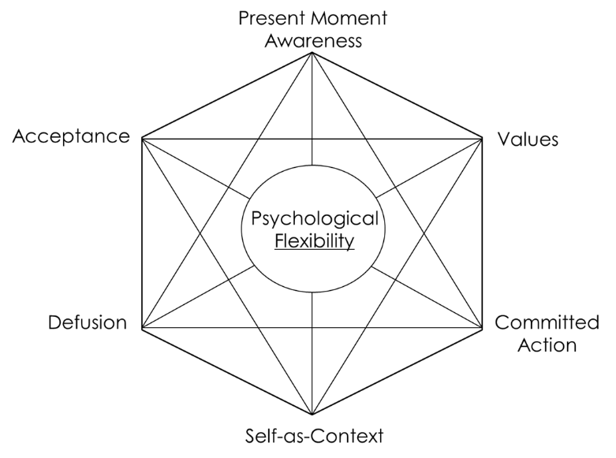
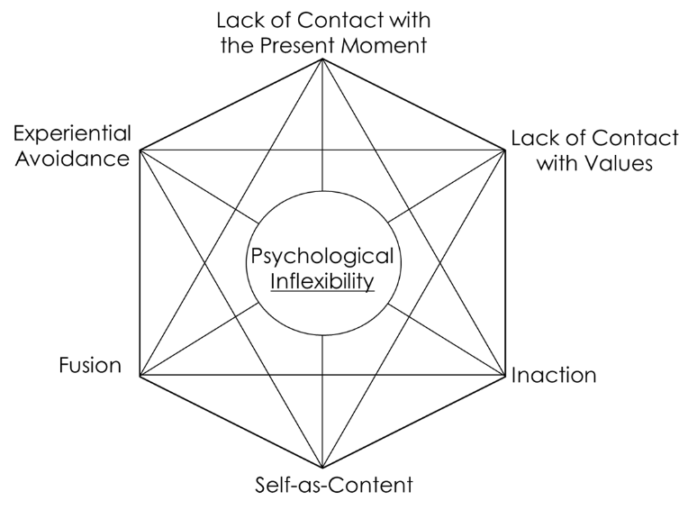
Psychological Flexibility & Inflexibility

Slide 34
Meta-analytic findings supporting Enduring Vulnerability Stress Adaptation Model
Attachment anxiety
Attachment avoidance
Trait inflexibility
Coparenting dynamics
Emotional support
Negative conflict
Aggression
Parenting styles
Enduring
Vulnerabilities
Individual Processes
Rel / Fam Processes
Rel / Fam
Functioning
Stressful
Events
Relationship satisfaction
Family cohesion
Parent stress
Child distress
State / dynamic flexibility
State / dynamic inflexibility

Slide 35
CURRENT GOALS
RCT of PAIR
compared to waitlist
FLEX / INFLEX
Mechanisms??

Slide 36
METHOD
T0
PAIR
1mo
2mo
T0
1mo
PAIR
2mo

Slide 37
SAMPLE
170 couples
92% married/engaged
Together 10.6 yrs
77% White
50% male
36yo

Slide 38
MEASURES
Baseline, 1mo, 2mo, 8mo
Rel Satisfaction (CSI)
Flexibility (MPFI)
Responsiveness (PRI)
Affection, Vitality

Slide 39
ANALYSES
HLM
nested within couples
nested within partners
Treatment effects
Correlated change

Slide 40
PAIR ➔ Δ Relationships
Drops in:
Insensitivity
Negative conflict behaviors
Increases in:
Affection Relationship Satisfaction
Responsiveness Vitality

Slide 41
PAIR ➔ Δ Flexibility / Inflexibility
No significant change
Global Flexibility
Specific forms of flexibility
Drops in;
Global inflexibility
Lack of contact with values

Slide 42
ΔINFLEX ➔ ΔRelationships
Drops in INFLEX (global & LCwV)
➔ lower insensitivity
➔ lower negative conflict
➔ higher responsiveness
➔ higher affection
➔ higher rel satisfaction
➔ higher VITALITY

Slide 43
Conclusions
PAIR promotes relationship health
reducing conflict / negativity
promoting connection

Slide 44
Conclusions
PAIR promotes relationship health
reducing conflict / negativity
promoting connection
Possibly by…
reconnecting with values
reducing inflexible/rigid responding

Slide 45
Thank you!!

